Slide 1


BATCH-11
Khushi Verma (217Z1A1225)
Sajjal Swathi (217Z1A1250)
Kommula Akshay (227Z5A1205)
CRYPTO
ASSIST BOT

Slide 2

OUTLINE
ABSTRACT
INTRODUCTION
EXISTING SYSTEM
PROPOSED SYSTEM
REQUIREMENT SPECIFICATION
CONCLUSION

Slide 3


ABSTRACT
BOT helps in estimating future Crypto currency prices
By comparing previous crypto prices by using Gold line Death line
Retrives the data from Yahoo Finance and generates a chart
Optimizes trading strategies through reliable predicitions of prices
Bot gives user a flexibility to give instructions

Slide 4





INTRODUCTION
Simplifies crypto trading and with advanced algorithms.
Automates trading tasks and offers 24/7 market monitoring.
Designed for all trader levels with an easy-to-use interface
Provides intelligent trading tips and market insights.

Slide 5
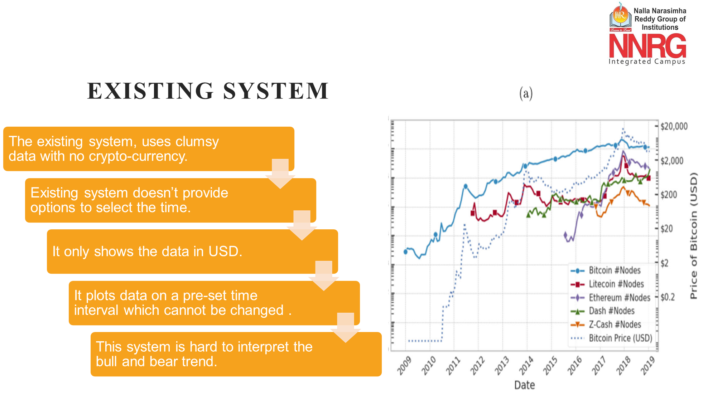

Slide 6





PROPOSED SYSTEM
Providing options,making trading eaiser
Plots the graph based to timeline given
Easy sharing and saving of plot details
Zoomed in,to get clear details at that point

Slide 7






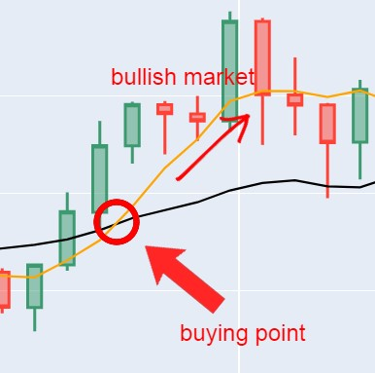
FLOW-CHART
Start and Receive User Command
Fetch Data from Yahoo Server
Identify Gold line and Death Line
Process and Analyze Data
Display Visual Data to User
Generate and Display Visuals
Show Market Trends

Slide 8

REQUIREMENT SPECIFICATION
Software Requirement
Hardware Requirement
RAM:4GB,Hard disk:50GB
Dual core processor
OS:Windows/Linux
Language:Python

Slide 9




CONCLUSION
Main aim is to predicate comparing previous crypto prices
An indispensable tool for future of cryptocurrency trading.
Make crypto market more approachable for beginners
Bot simplifies crypto trading with advanced algorithms and real-time data.

Slide 10


